Slide 1
Xamarin platform news Mykhail Galushko co-founder DevRain Solutions, Microsoft MVP

Slide 2
Agenda
Xamarin Insights
Xamarin Test Cloud
Xamarin Sketches
Xamarin Forms

Slide 3
Xamarin platform
Complete mobile solution
^{Xamarin Platform}
^{Xamarin}
^{University}
^{Xamarin} ^{Insights}
^{Xamarin Test Cloud}

Slide 4

Xamarin Insights
Analytics and crash reporting
Preview status
Free for use for now
Overview
Key features
Demo

Slide 5
Xamarin Insights: supported platforms
Xamarin.iOS
Xamarin.Android
Xamarin.Mac
Xamarin.Forms
Windows Phone
Windows Store
Windows Desktop

Slide 6
Xamarin Insights: features
Automatical reporting for exceptions
Manual reporting for exceptions
Events tracking
Operation’s performance tracking
Identifying user during tracking
Offline mode
Integration with third-party services: Github, VS etc

Slide 7
Demo

Slide 8
Xamarin Insights: alternatives
Application Insights from Microsoft
Splunk MINT (former Bugsense)
Crashlytics
N more services focused on Android and iOS

Slide 9
Xamarin Test Cloud
Main problems for testing mobile apps:
Device fragmentation
iOS: 6 screen sizes, 5 OS versions
Android: 27 screen sizes, 9 OS versions, 15 manufacturers
Short development & release cycles
User expectations for high quality solution

Slide 10
Xamarin Test Cloud
High Test Realism
Beta Testing
Automated UI Testing
Manual Testing
Rapid Iterations
Long Cycles
Unit Testing
Simplistic Tests

Slide 11
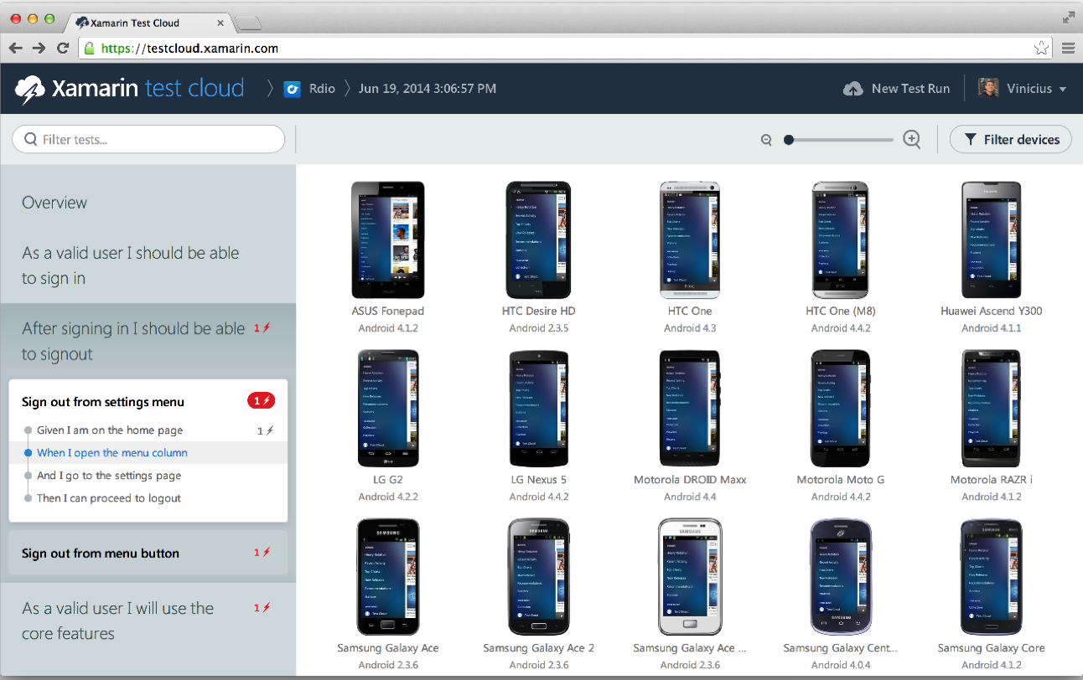
Xamarin Test Cloud
Automated UI tests: Xamarin.UITest or Calabash
Test Cloud service for testing on large number of devices (more then 1000)
You can run locally with IDE
Works for any app type: native, Xamarin, hybrid
Supports organization and teams
Prices are high
Hard to get access ☺

Slide 12

Xamarin Sketches
Interactive, real-time code experiments (C#)
Supports:
Xamarin.iOS
Xamarin.Android
Xamarin.Mac
Xamarin.Forms

Slide 13
Xamarin Sketches
Classic code experiment process:
Create new application
Add logging to UI or console
Make tests and validate results

Slide 14
Xamarin Sketches
Current features:
No class & method support, use Tuple and Func
Android in early preview
Works only on Mac (Xamarin Studio)
F# is coming soon
Line-by-line evalution

Slide 15
Demo

Slide 16
Xamarin Forms
Cross-platform: iOS, Android, Windows Store and Windows Phone
Every Forms control mapped to native control
XML layout
MVVM support (two-way data binding, commands)
Built in: navigation, animation API, dependency service, messaging center
Async-await support

Slide 17
Q&A

